Slide 1

IMAGE SCRAPPING AND CLASSIFICATION PROJECT
Hinal Seth

Slide 2
Contents
Introduction
Conceptual Background of the Domain Problem
Motivation for the Problem Undertaken
Visualizations
Conclusion

Slide 3
Introduction
Business Problem Framing:
Data scrapping used for collecting data of particular site for insufficient data and for image classification CNN method is used to teach a machine about that particular image.
More than 25% of the whole revenue in E-Commerce is attributed to apparel & accessories. a serious problem they face is categorizing these apparels from just the pictures especially when the categories provided by the brands are inconsistent. This poses a stimulating computer vision problem that has caught the eyes of several deep learning researchers.

Slide 4
Conceptual Background of the Domain Problem
Data science plays an important role to solve business problems by which companies increase their profits and improve business strategies. Our objective is to create a Classification model that classifies the image of each clothing category (which is scraped from an E-Commerce website) focusing on changing trends.

Slide 5
Motivation for the Problem Undertaken
Every problem begins with ideas that are further developed and inspired to address a variety of situations and circumstances. Learning the theoretical background for data science or machine learning are often a frightening experience, because it involves multiple fields of mathematics and an extended list of online resources. By proper practical research and practice I can become better in this field. These suggestions are derived from my mentors/SME’s and my own experience in the beginner projects.

Slide 6
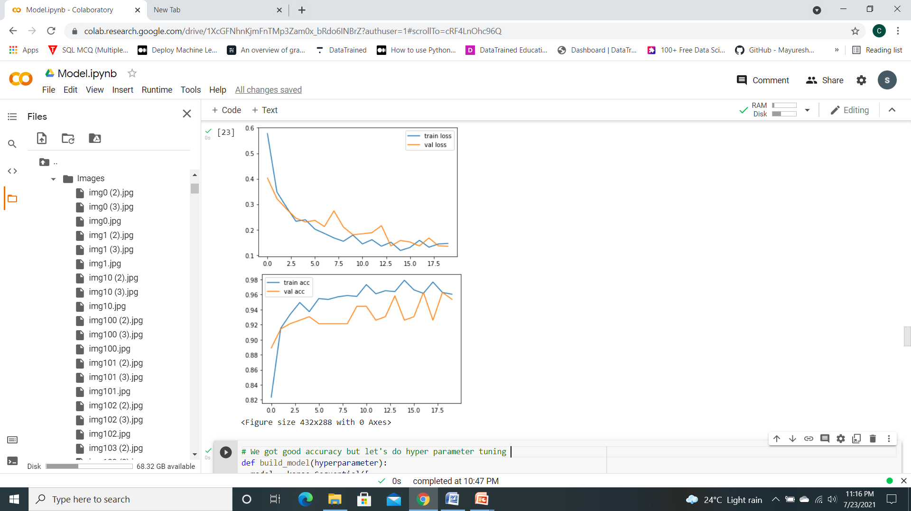
Visualizations

Slide 7
Conclusion
Key Findings and Conclusions of the Study:
Predicting the image uploaded to Google colab and predicted with the model and got the expected result.
Learning Outcomes of the Study in respect of Data Science:
By using selenium scrapping images from amazon made easy.By using optimizers, layers and filters observed that there is difference in scoring.RMSprop optimizer gave best score.

